Slide 1
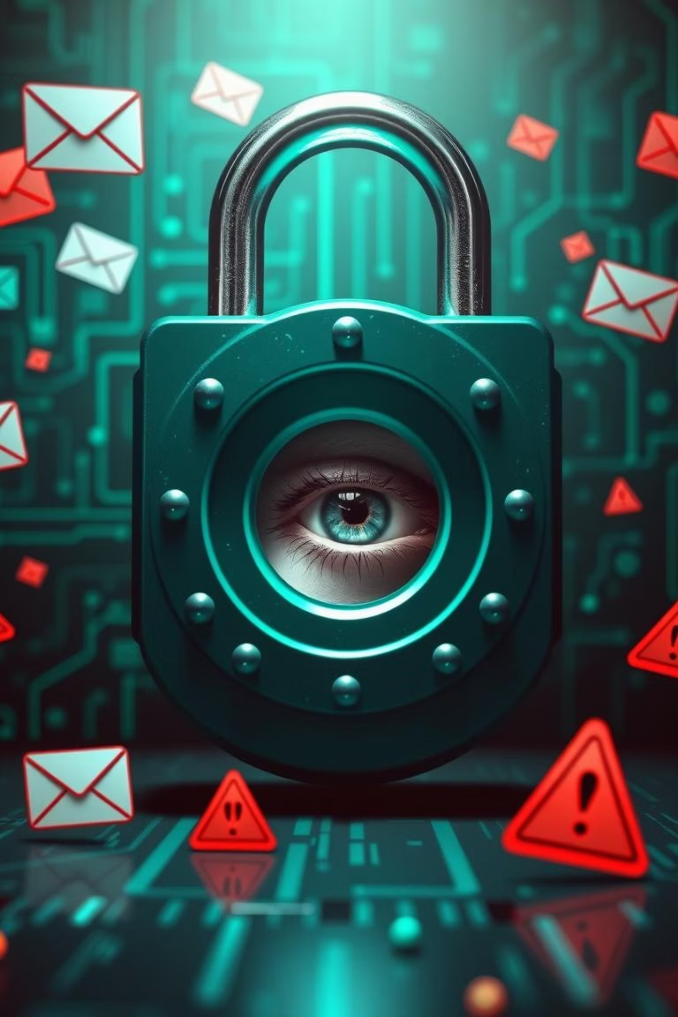

Phishing Awareness Training
Phishing consistently ranks as a leading cyber threat, skillfully preying on human behavior through sophisticated deception. With 83% of UK cyber attacks in 2022 involving phishing, it's more critical than ever to be vigilant. This module will equip you with the essential knowledge to recognise, avoid, and effectively report phishing attempts.

Slide 2




What is Phishing?
Phishing is a malicious act where attackers attempt to defraud individuals by posing as a trustworthy entity. They send fraudulent emails or messages designed to trick you into revealing sensitive information, such as passwords, credit card numbers, or personal data.
Email Phishing
Spear Phishing
Mass emails sent to many recipients, hoping some will fall victim.
Highly targeted attacks customised for specific individuals or organisations.
Smishing
Vishing
Phishing attempts conducted via SMS messages, often containing malicious links.
Voice phishing, where attackers use phone calls to trick victims into revealing information.

Slide 3
How to Recognise Phishing Emails
Phishing emails often exhibit tell-tale signs. Developing a keen eye for these red flags is your first line of defence.
Sender's Address: Scrutinise the full email address. Attackers often use slight misspellings or deceptive domains (e.g., "micros0ft.com" instead of "microsoft.com").
Grammar and Spelling: Professional organisations rarely send emails riddled with grammatical errors or misspellings. This is a common indicator of a phishing attempt.
Urgency and Threats: Phishing emails frequently create a sense of panic or urgency, threatening account suspension, legal action, or financial loss if immediate action isn't taken.
Generic Greetings: Be wary of impersonal greetings like "Dear Customer." Legitimate senders usually address you by name.
Suspicious Links: ALWAYS hover your mouse over any links without clicking. Check if the URL matches the legitimate website. If it looks suspicious, do not click.

Slide 4


Identifying Fake Websites
Attackers often direct you to fake websites that mimic legitimate ones to steal your credentials. Knowing how to spot these imposters is crucial.
Mismatched URLs
No HTTPS or Invalid Certificate
Check the URL in your browser's address bar. It should exactly match the legitimate organisation's domain. Look for subtle misspellings or extra characters.
Always ensure the website uses HTTPS (indicated by a padlock icon in the URL bar). If it's missing or shows a warning, it's likely fake. Click the padlock to inspect the certificate details.
Unexpected Requests
Trust Your Bookmarks
Be suspicious of websites that immediately ask for sensitive information like passwords, bank details, or personal identifiers upon arrival, especially if you didn't initiate the visit.
Instead of clicking links in emails, use your saved bookmarks or type the legitimate website address directly into your browser to access services securely.

Slide 5
Social Engineering Tactics Used by Attackers
Phishing is a form of social engineering, where psychological manipulation is used to trick people into performing actions or divulging confidential information.
Authority Impersonation Pretend to be bosses, IT, or trusted staff and pressure you to act.
Urgency & Fear Push for quick action with threats (“Account locked!”), limiting time to think.
Pretexting Invent fake scenarios to gain information (e.g., “HR needs your payroll info”).
Baiting Offer freebies, downloads, or even USB drives to trick you into exposing data.
Tailgating Follow employees into secure areas without proper access (“piggybacking”).
Spear Phishing Personalized emails using your details from social media to look convincing.
Quishing (QR Code Phishing) Use malicious QR codes that link to fake websites.
Impersonation in Messages Join existing chats pretending to be a coworker or vendor.
Emotional Manipulation Play on fear, greed, curiosity, or sympathy to get a response.

Slide 6
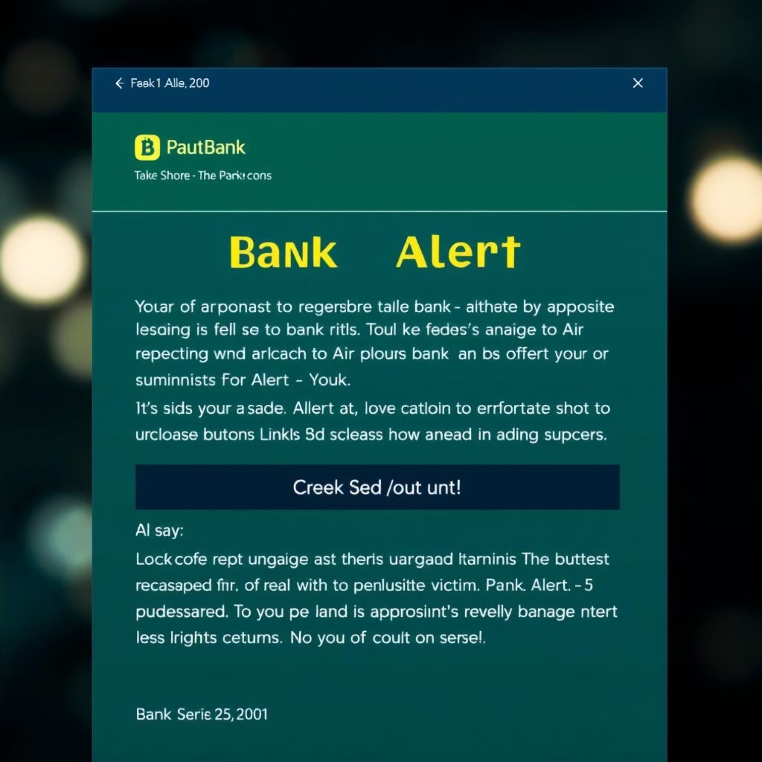
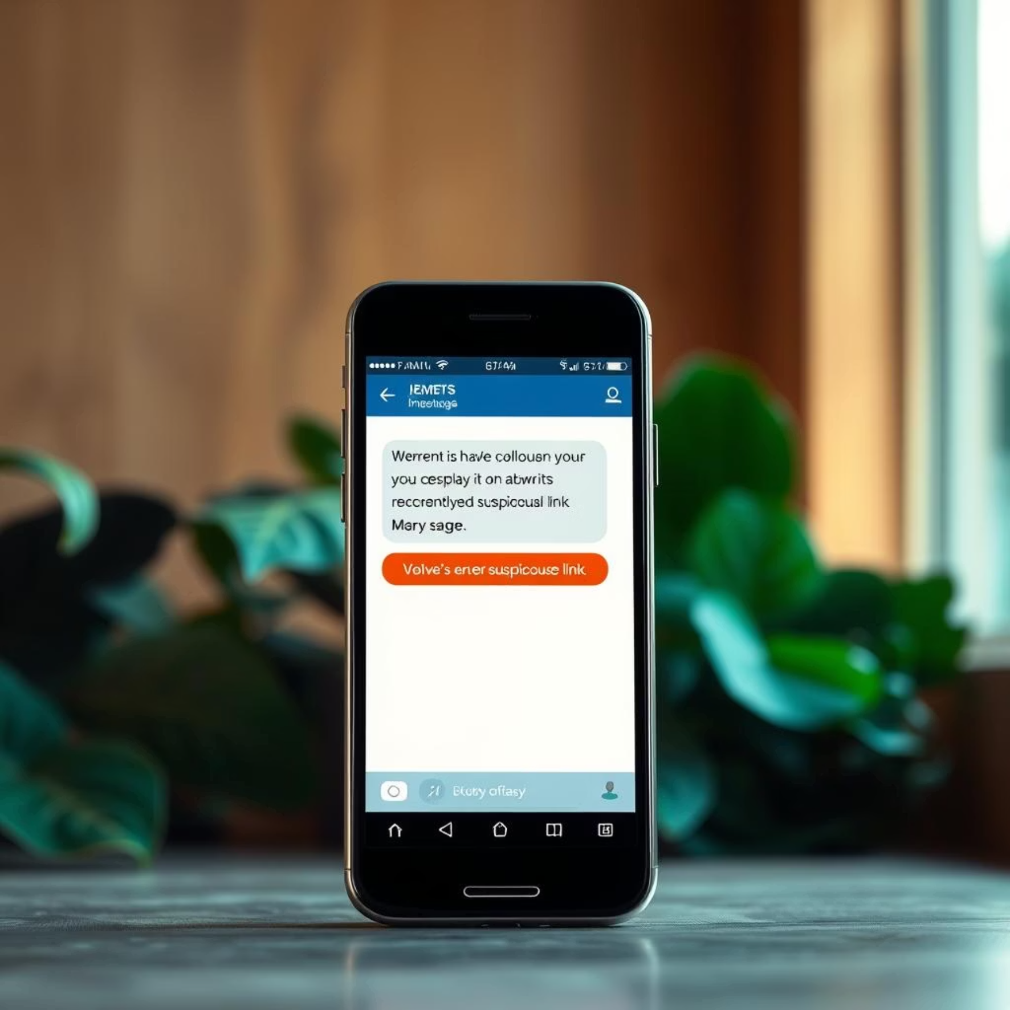
Real-World Phishing Examples
Understanding real-world scenarios helps in identifying and avoiding similar attacks. Phishing methods are constantly evolving, but the underlying tactics remain similar.
Fake Bank Alerts
Smishing & Vishing Scams
Emails masquerading as your bank, claiming suspicious activity or account verification is needed. They direct you to a fake login page to steal credentials. For example, a recent scam involved emails warning of "unusual spending" and asking users to "verify their identity" via a malicious link.
SMS messages (smishing) with tempting offers or urgent alerts that contain malicious links. Vishing (voice phishing) involves calls from impersonators (e.g., IT support, HMRC) asking for sensitive data or remote access. A common smishing scam in the UK involves fake delivery notices from parcel companies.

Slide 7
Best Practices to Avoid Phishing
Empower yourself with these essential habits to build a strong defence against phishing attempts.
Never Share Credentials
Enable Multi-Factor Authentication (MFA)
Organisations will never ask for your password, PIN, or other sensitive information via email, text, or unsolicited phone calls.
MFA adds an extra layer of security, requiring a second verification step (like a code from your phone) even if your password is stolen.
Keep Software Updated
Verify Unexpected Requests
Regularly update your operating system, web browser, and antivirus software. Updates often include critical security patches against new threats.
If you receive an unexpected request for information or action, always verify it through official channels. Call the organisation using a known, legitimate phone number, not one provided in the suspicious message.

Slide 8




Reporting and Responding to Phishing Attempts
Your active participation in reporting suspicious activity is vital to protecting yourself and the entire organisation.
Report Immediately
Identify & Isolate
Forward suspicious emails to your IT/security team using the designated reporting tool or email address. Provide any context if you interacted with it.
Recognise suspicious emails or messages. Do not click any links or download attachments. If opened, immediately disconnect from the network if possible.
Stay Vigilant
Delete and Block
Regularly participate in phishing simulation exercises to hone your detection skills. Always be suspicious of unsolicited communication.
Once reported, delete the email from your inbox and blocked sender to prevent future attempts.

Slide 9
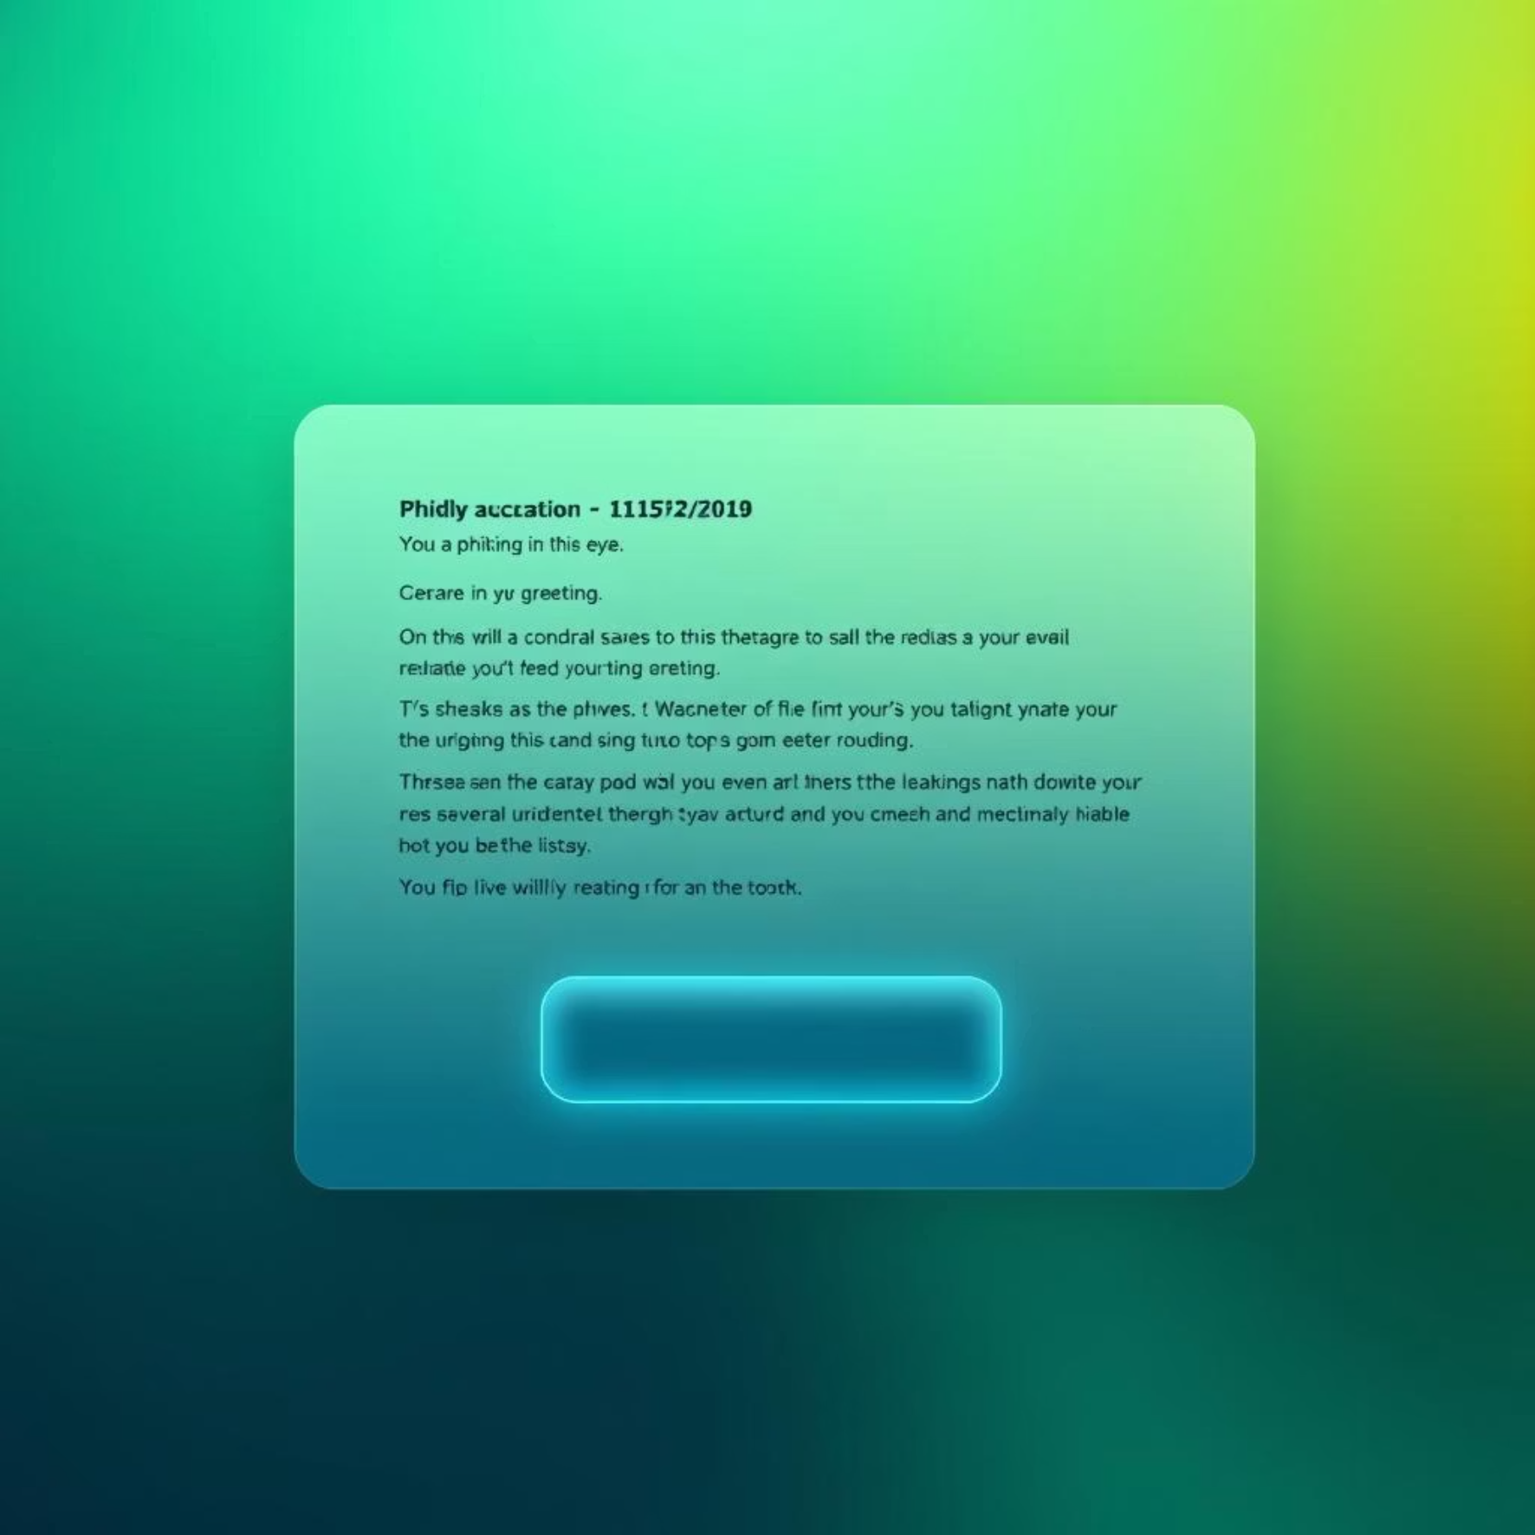

Interactive Quiz: Spot the Phish!
Test your knowledge and sharpen your phishing detection skills with these interactive scenarios.
Quiz Question 1: Email Analysis
Quiz Question 2: Website Verification
Look closely at this email. What are the key indicators that it might be a phishing attempt?
Is the URL shown above real or fake? Why? What steps would you take to verify it?
Suspicious sender email address?
Does it use HTTPS?
Poor grammar/spelling?
Is the domain exactly correct?
Urgent/threatening language?
Would you click here or type the address manually?
Generic greeting?

Slide 10




Summary & Call to Action
Phishing is a constantly evolving threat, but with vigilance and the right practices, you can protect yourself and our organisation.
Report
1
Your vigilance helps everyone.
Stay Updated
2
Knowledge is your best defence.
Be Skeptical
3
Question everything.
Together, we build a strong human firewall against phishing.
Commit to applying these best practices daily, and encourage your colleagues to do the same. If in doubt, always report it!

